Slide 1

Transparent Healthcare
Costs System
(THCS)
INFO 5100 – Application Engineering & Development
Professor: Kal Bugrara

Slide 2


Project Team : Dev Divas
Gayathri Thammana
MS in Information Systems
NU ID # 001388264
Email id : thammana.g@husky.neu.edu
Mahitha Mandalapu
MS in Information Systems
NU ID # 001387807
Email id : mandalapu.v@husky.neu.edu

Slide 3
Contents:
Mission
Inspiration
Problems Addressed
Solution
Class diagram
Object model
Use cases
Functionality Overview
THCS Roles
Graphs & Reports
Screens
API’s
Future Enhancements
Project Team

Slide 4
Mission
”
Our mission is to achieve meaningful price transparency in Health care system to standardize health care costs and empower patients to make informed care decisions.
The lack of complete, accurate, and timely information about the cost of health care services prevents health care markets from operating efficiently.
”

Slide 5
Inspiration
”
Growing market demand for Healthcare price transparency.
Inefficient regulatory agencies could not standardize health costs.
Irregular treatment pricing means transparency and standardization needed
System fills a market niche and does so cost effectively
”
TEDtalk:
What_if_all_us_health_care_costs_were_transparent - Jeanne Pinder

Slide 6
Problems addressed
”
In the US, the very same blood test can cost $19 at one clinic and $522 at another clinic just blocks away and nobody knows the difference until they get a bill weeks later.
This in turn paralyses patient trust with hospitals, insurance companies and government and even the entire healthcare system.
Literally, no one knows how the final bill would look like. Few people price-shop for health care before visiting and even hospitals or insurance providers clueless about how the final bill would look like.
Everyone’s flying blind
”

Slide 7
Solution: THCS
”
THCS is a futuristic company that builds platform that crowdsources the true costs of medical procedures and makes the data public, revealing the secrets of health care pricing.
Knowing what stuff costs in advance could make us healthier, save us money and help fix a broken system.
”

Slide 8
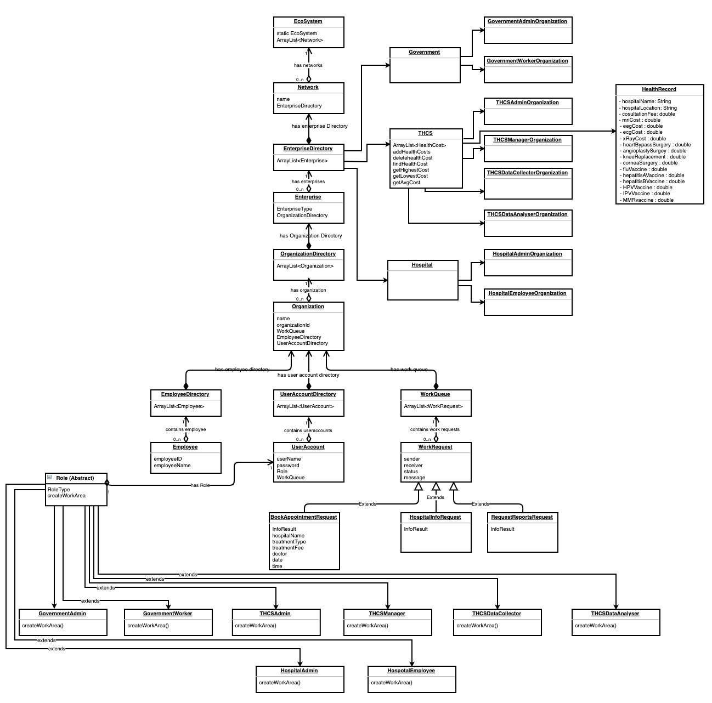
Class Diagram

Slide 9
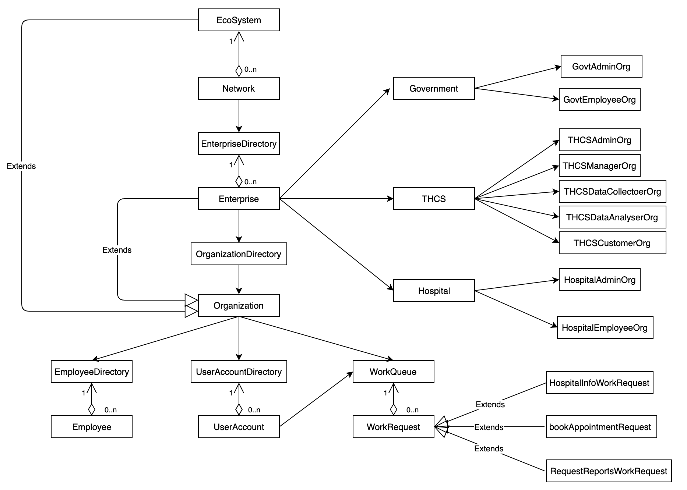
Object Model

Slide 10

Use case 1: THCS collects, analyses and prepares price reports
THCS
Data Collector
2. Collects hospitals price costs
for numerous medical procedures
THCS Manager
1. Initiates data
aggregation
and analysis
Data Analyzer
3. Transforms, analyses data and
prepares graphs, reports

Slide 11

Use case 2: Govt requests THCS for price reports
THCS
Government
Data Collector
3. Collects hospitals price costs
for numerous medical procedures
Govt Employee
THCS Manager
1. Requests THCS for price reports
2. Initiates data
aggregation
and analysis
Data Analyzer
4. Transforms, analyses data and
prepares graphs, reports

Slide 12
Use case 3: Book Hospital Appointment
Patient
Hospital
Requests Hospital for
appointment
Patient
Hospital Employee
Process the request and book appointment

Slide 13
Functionality Overview
”
Data Collection:
collect the true costs of medical procedures from patients
Data Analysis:
Transforming the collected data into helpful insights to enable patients to make cost efficient decisions
Reporting results to Government:
Reports and insights of phase 2 will reported to Government for standardization and transparency.
Reporting results to patients:
Hospital offering cheapest medical procedure will be reported to patients so that they can book appointments.
Phases Involved:
”

Slide 14
THCS Roles
”
SysAdmin
THCS Admin
THCS Manager
THCS Data Collector
THCS Data Analyser
Customer
Govt Admin
Govt Employee
Hospital Admin
Hospital Employee
”

Slide 15
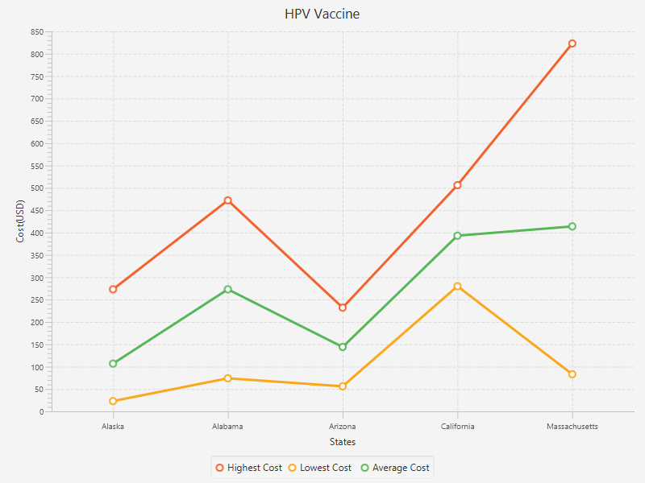
Compare costs in US states

Slide 16
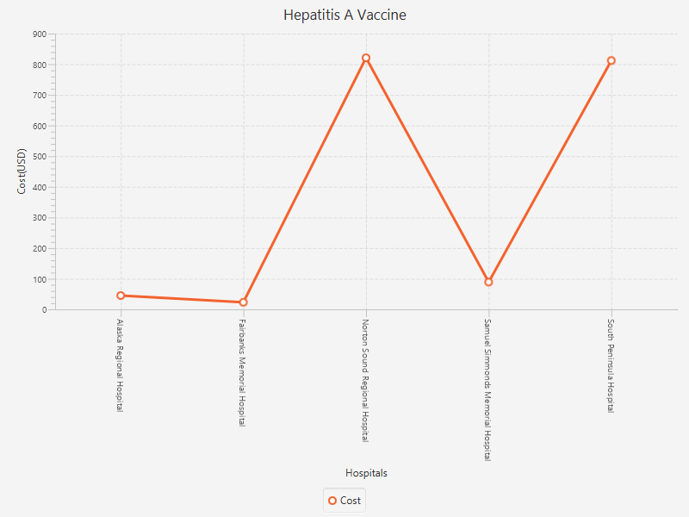
Compare costs in hospitals in a state

Slide 17
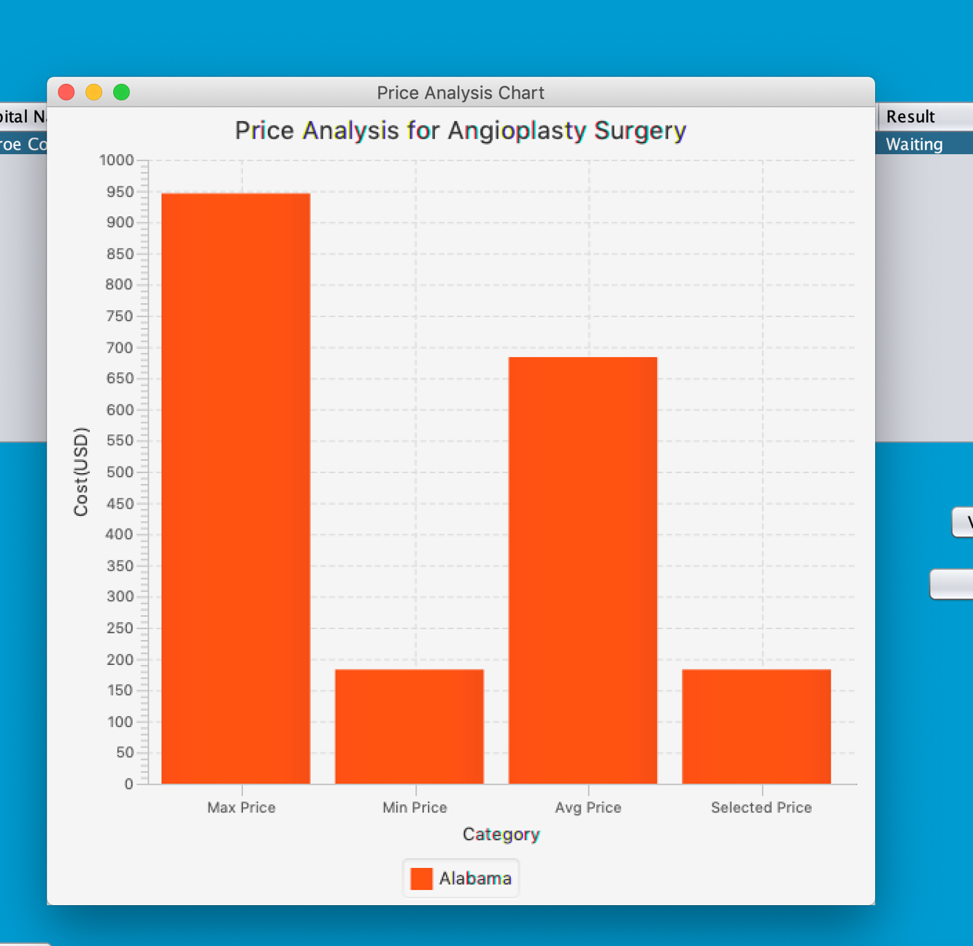
Compare costs of a surgery in a state

Slide 18
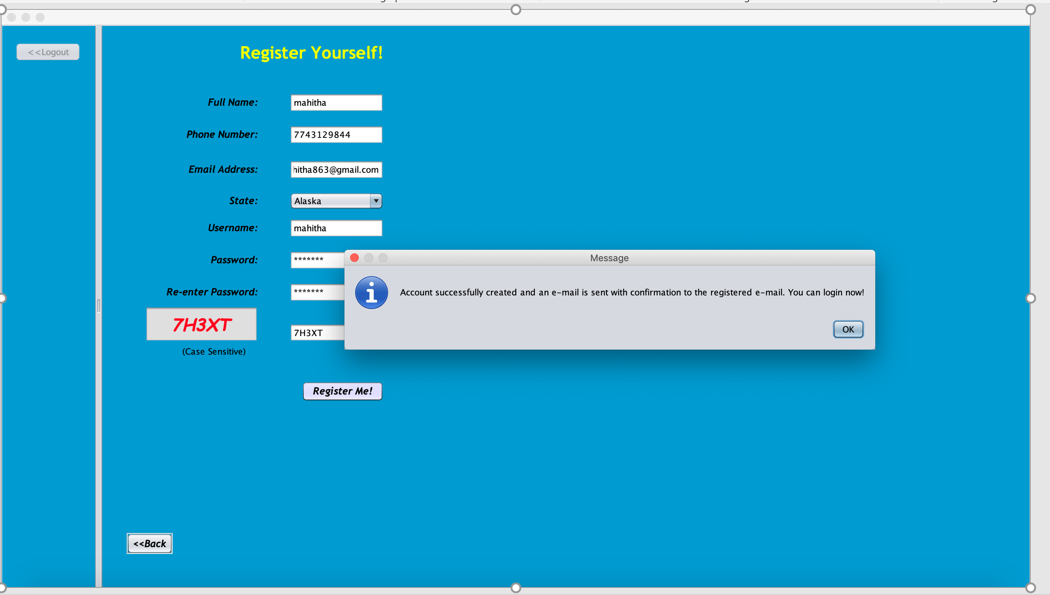
Patient Sign up form

Slide 19
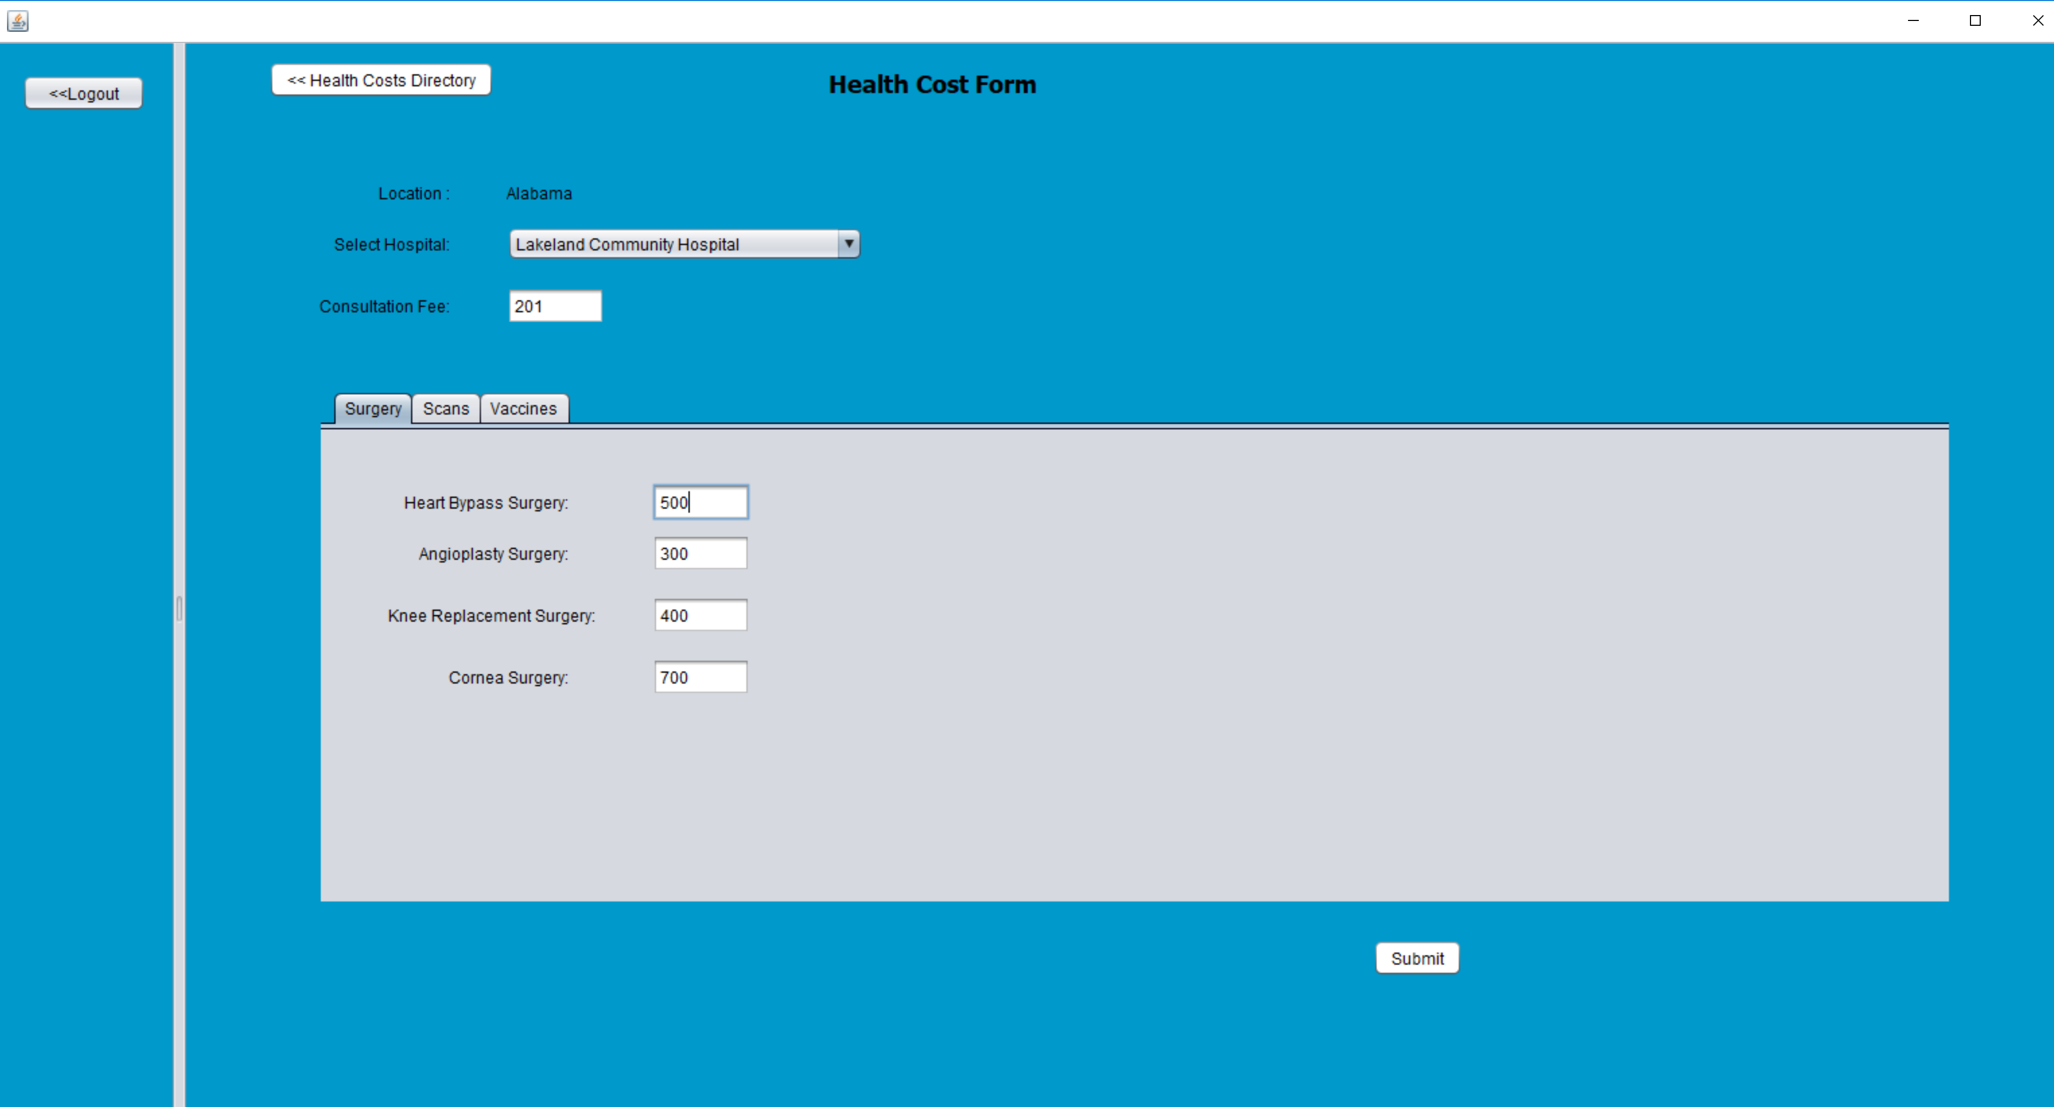
Health Cost Form – Data Collector

Slide 20
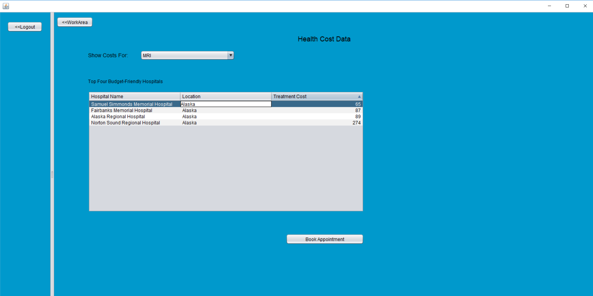
Health Costs of Hospitals And Booking Appointment

Slide 21
API’s
”
API:
Charts : JavaFX
Email : JavaX Mail
PDF : iTextPDF
Excel : Apache POI
MISC:
Captcha
Encryption
”

Slide 22
Future Enhancements
”
We can involve following enterprises in the ecosystem
Insurance Companies - Analyze and identify best insurance provider based on deductible, co-pay, co-insurance for a specific medical treatment
2. Employers – Companies can contact THCS for best insurance provider
”

Slide 23

Thanks!

